Slide 1

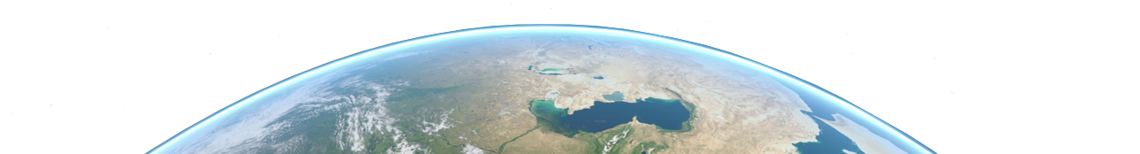


Mission Analysis in Python
A “how-to” crash course
04/2023

Slide 2

Table of Contents
Introduction
Python Workflow
Tools Used & Recommended
Installation & Testing
Collaborative Coding
Useful Links
TOLOSAT
05/2021
Mission Analysis in Python
2

Slide 3


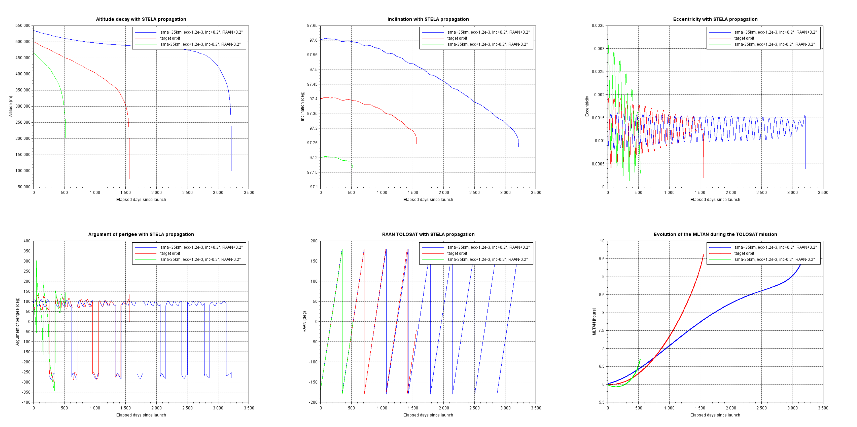
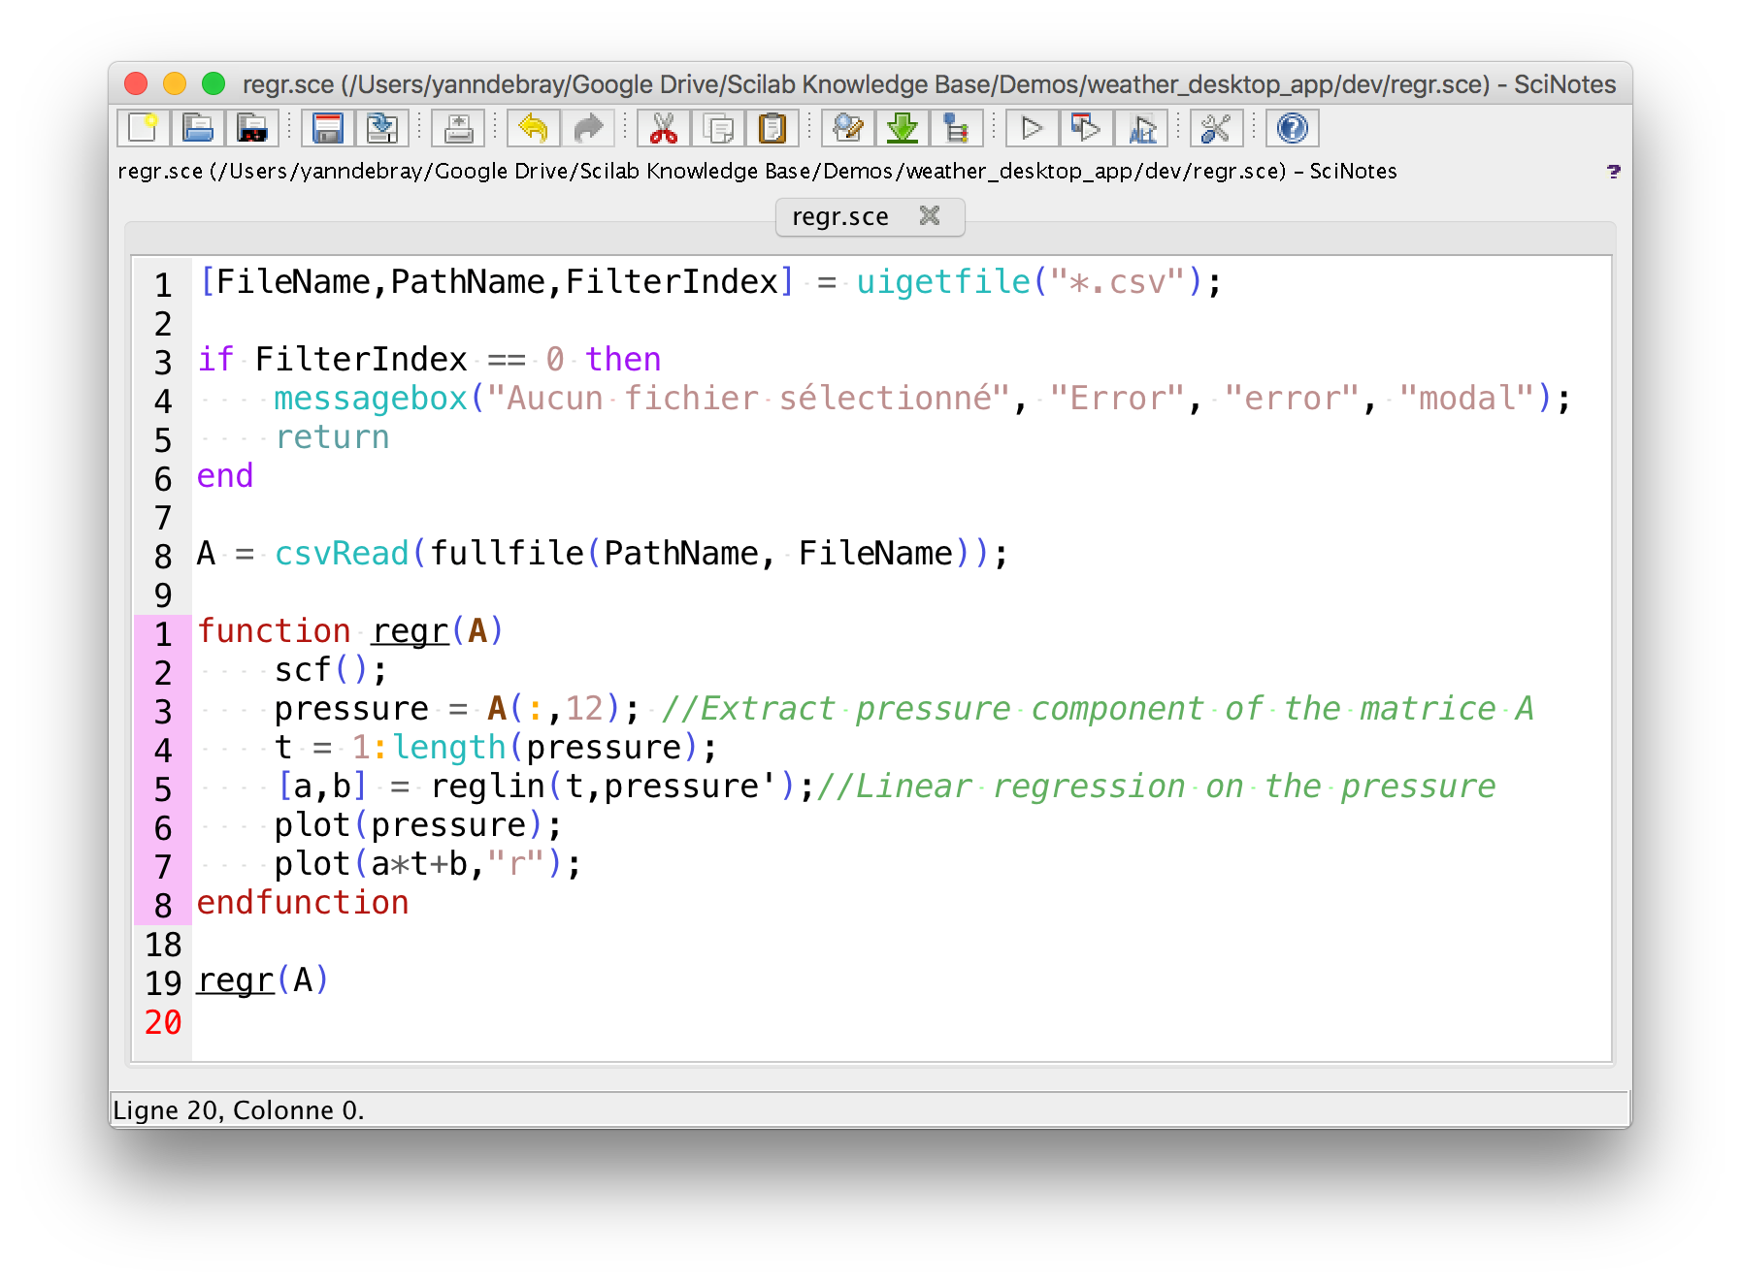
Introduction
Some historical context
TOLOSAT
05/2021
Mission Analysis in Python
3

Slide 4
Introduction
TOLOSAT
Why move to Python ?
More modern and flexible language
Easy to learn and use, still allows for high-performance applications through interfaces
Scilab very limiting and outdated (CNES also looking into moving to Python)
Opens access to many free and open-source libraries available
Free choice of IDE and development environment, can wield the power of plugins, etc.
More modular code, easier to collaborate with other subsystems when needed
05/2021
Mission Analysis in Python
4

Slide 5
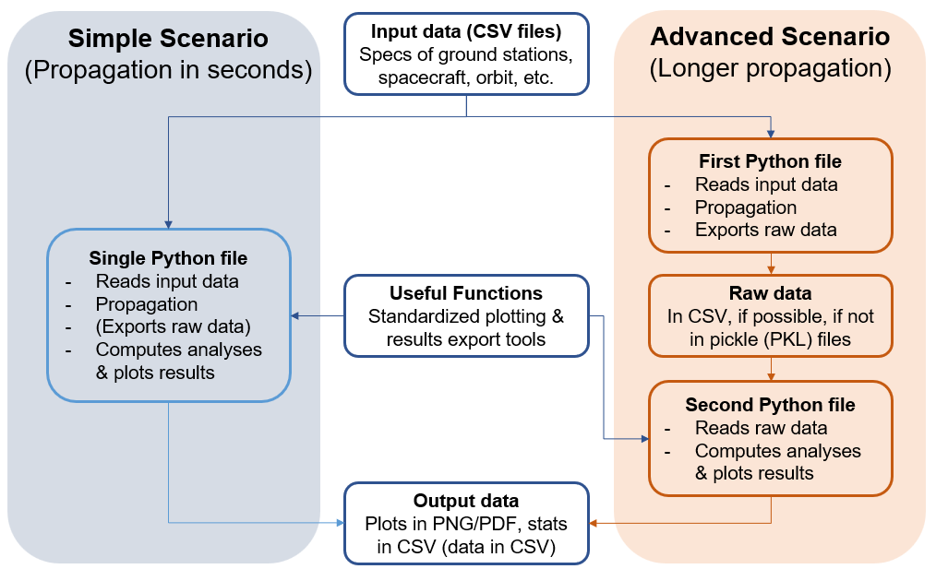
Python Workflow
TOLOSAT
05/2021
Mission Analysis in Python
5

Slide 6
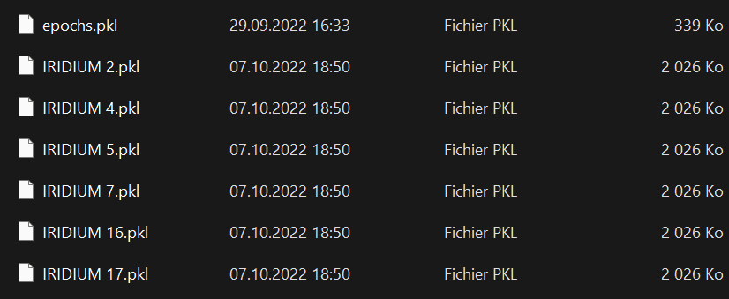
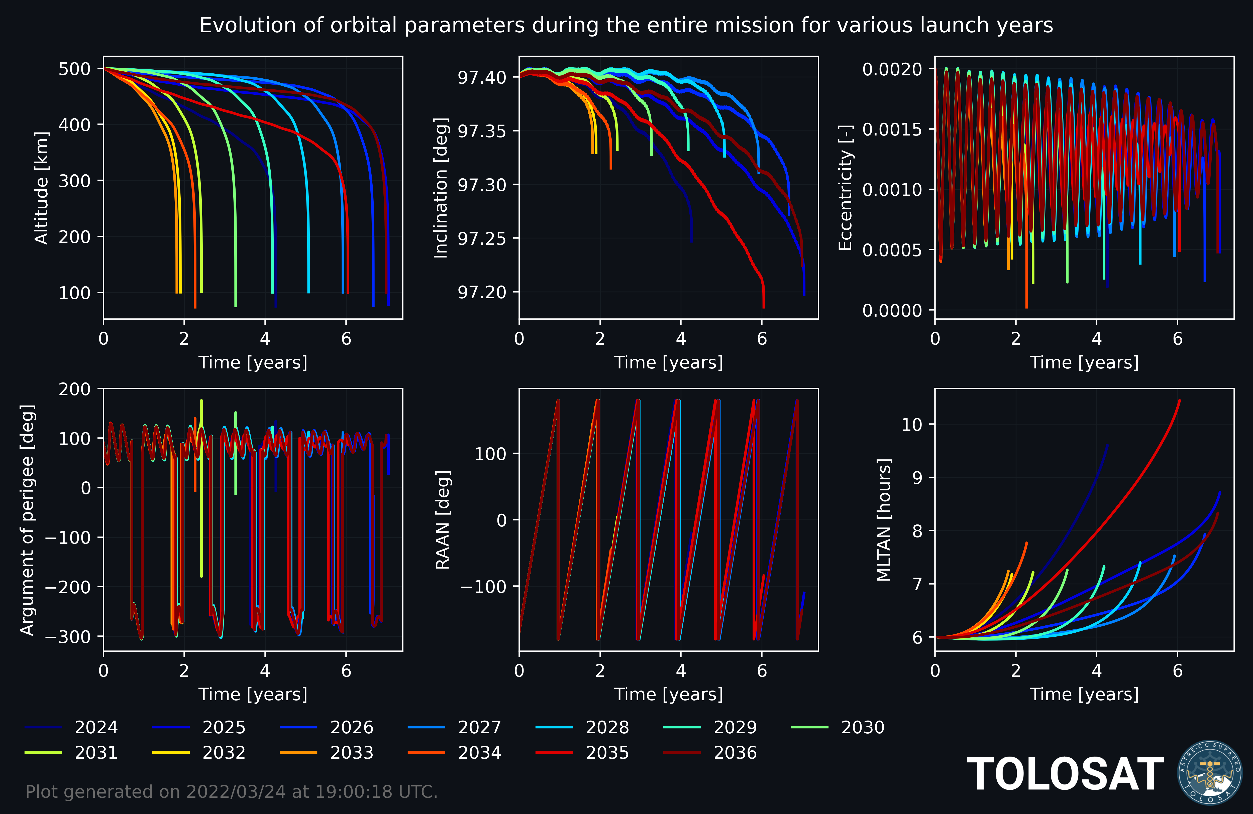
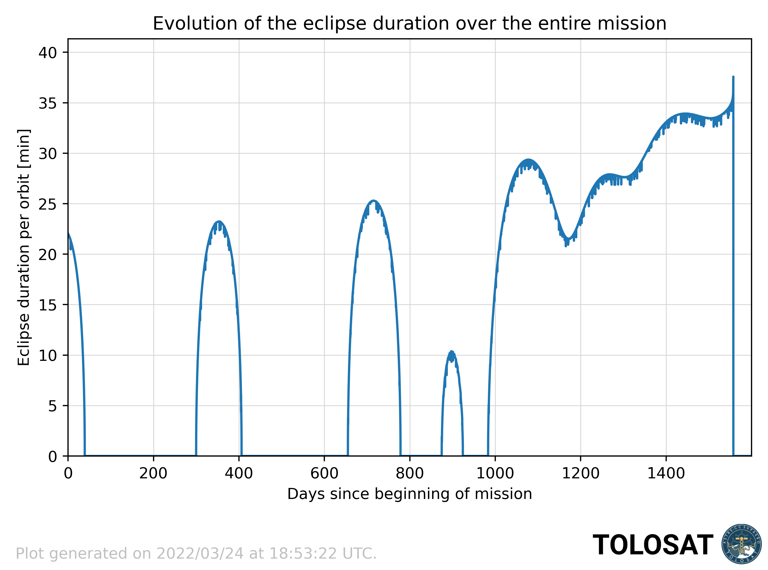
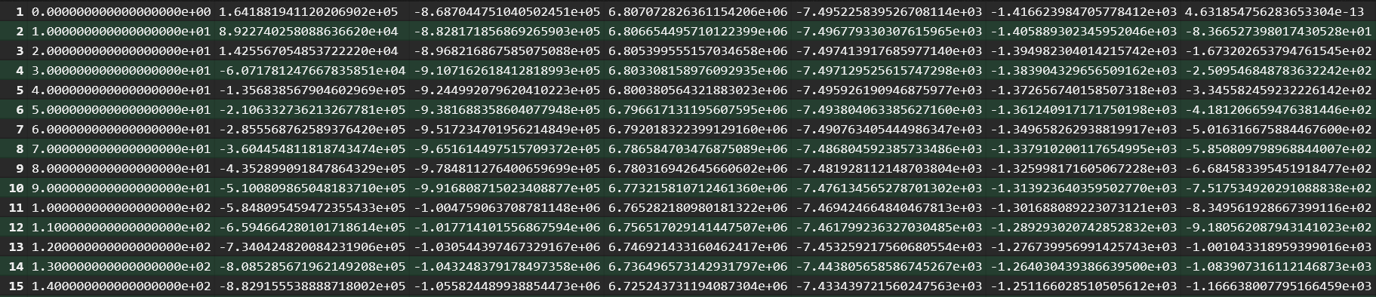
Python Workflow
TOLOSAT
05/2021
Mission Analysis in Python
6

Slide 7






Tools Used & Recommended
Used
Recommended
TOLOSAT
GitHub Desktop
05/2021
Mission Analysis in Python
7

Slide 8
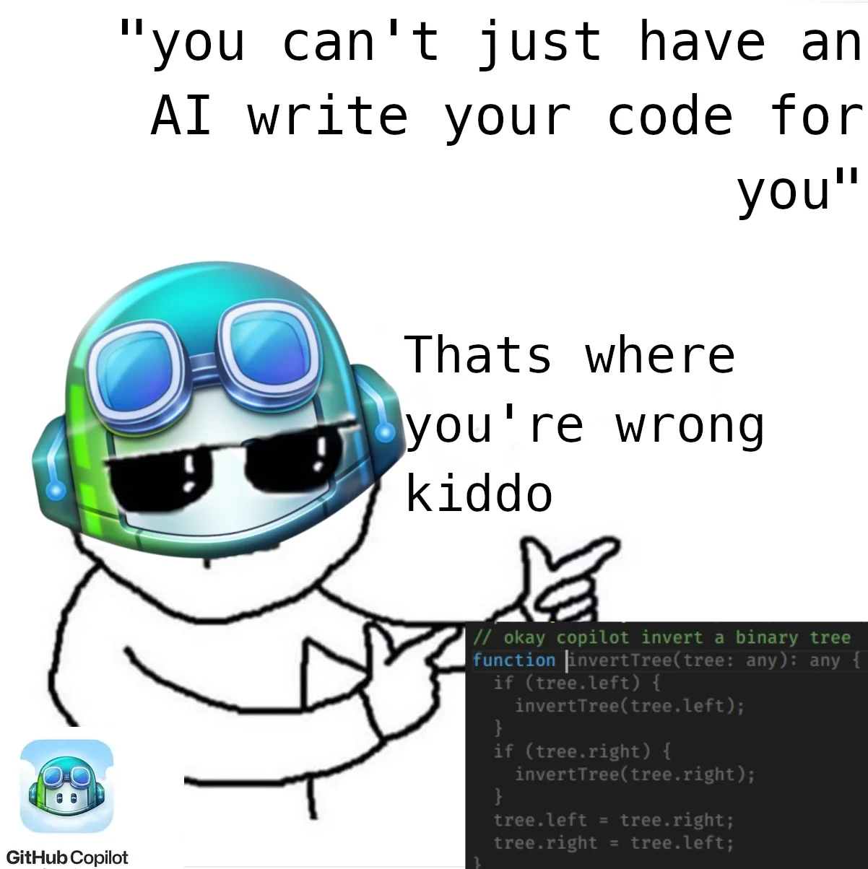
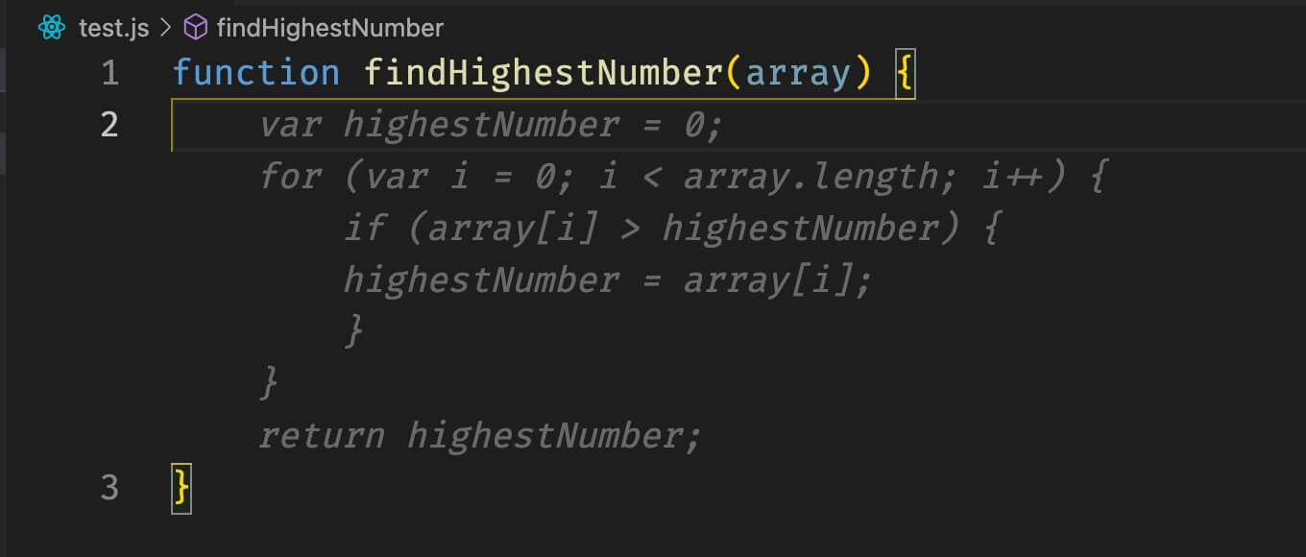
Tools Used & Recommended
Important notes
CONDA → You can use ANACONDA, or Miniforge for a lighter install
PyCharm → Free professional licenses for students (see Python setup guide)
GitHub Copilot → Free for students through the GitHub Global Campus program
TOLOSAT
05/2021
Mission Analysis in Python
8

Slide 9
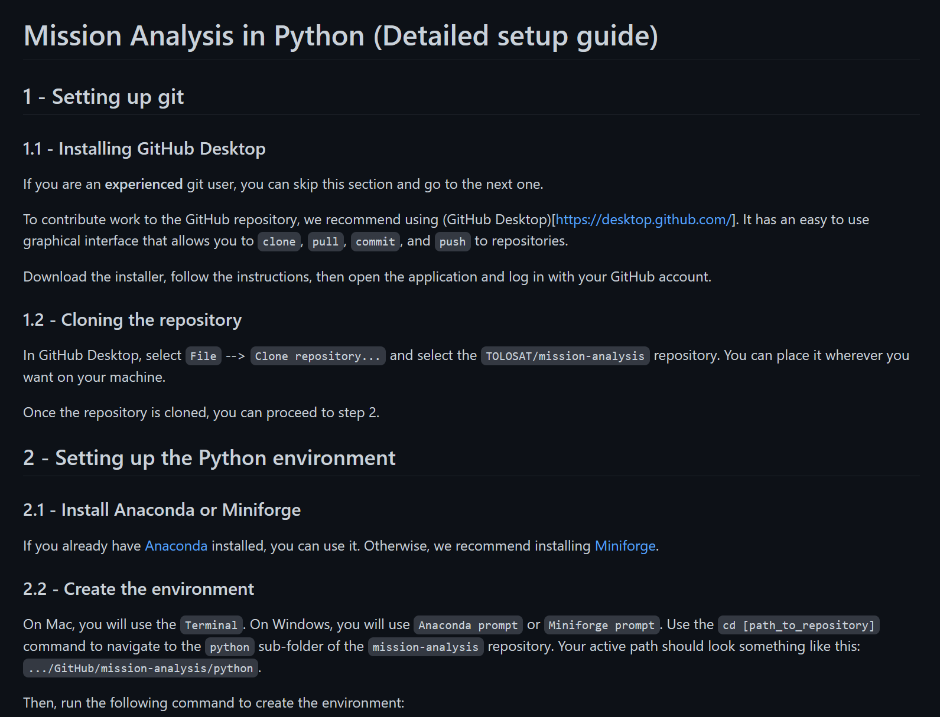
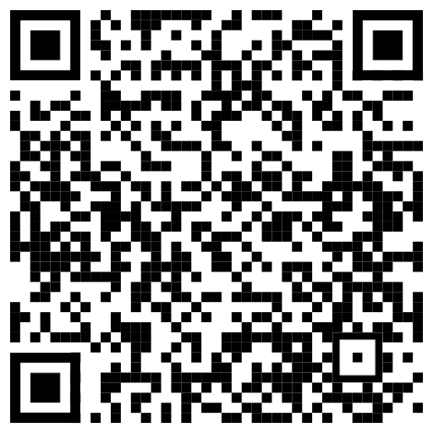
Installation & Testing
https://github.com/TOLOSAT/mission-analysis/blob/main/python/setup_guide/README.md
TOLOSAT
05/2021
Mission Analysis in Python
9

Slide 10
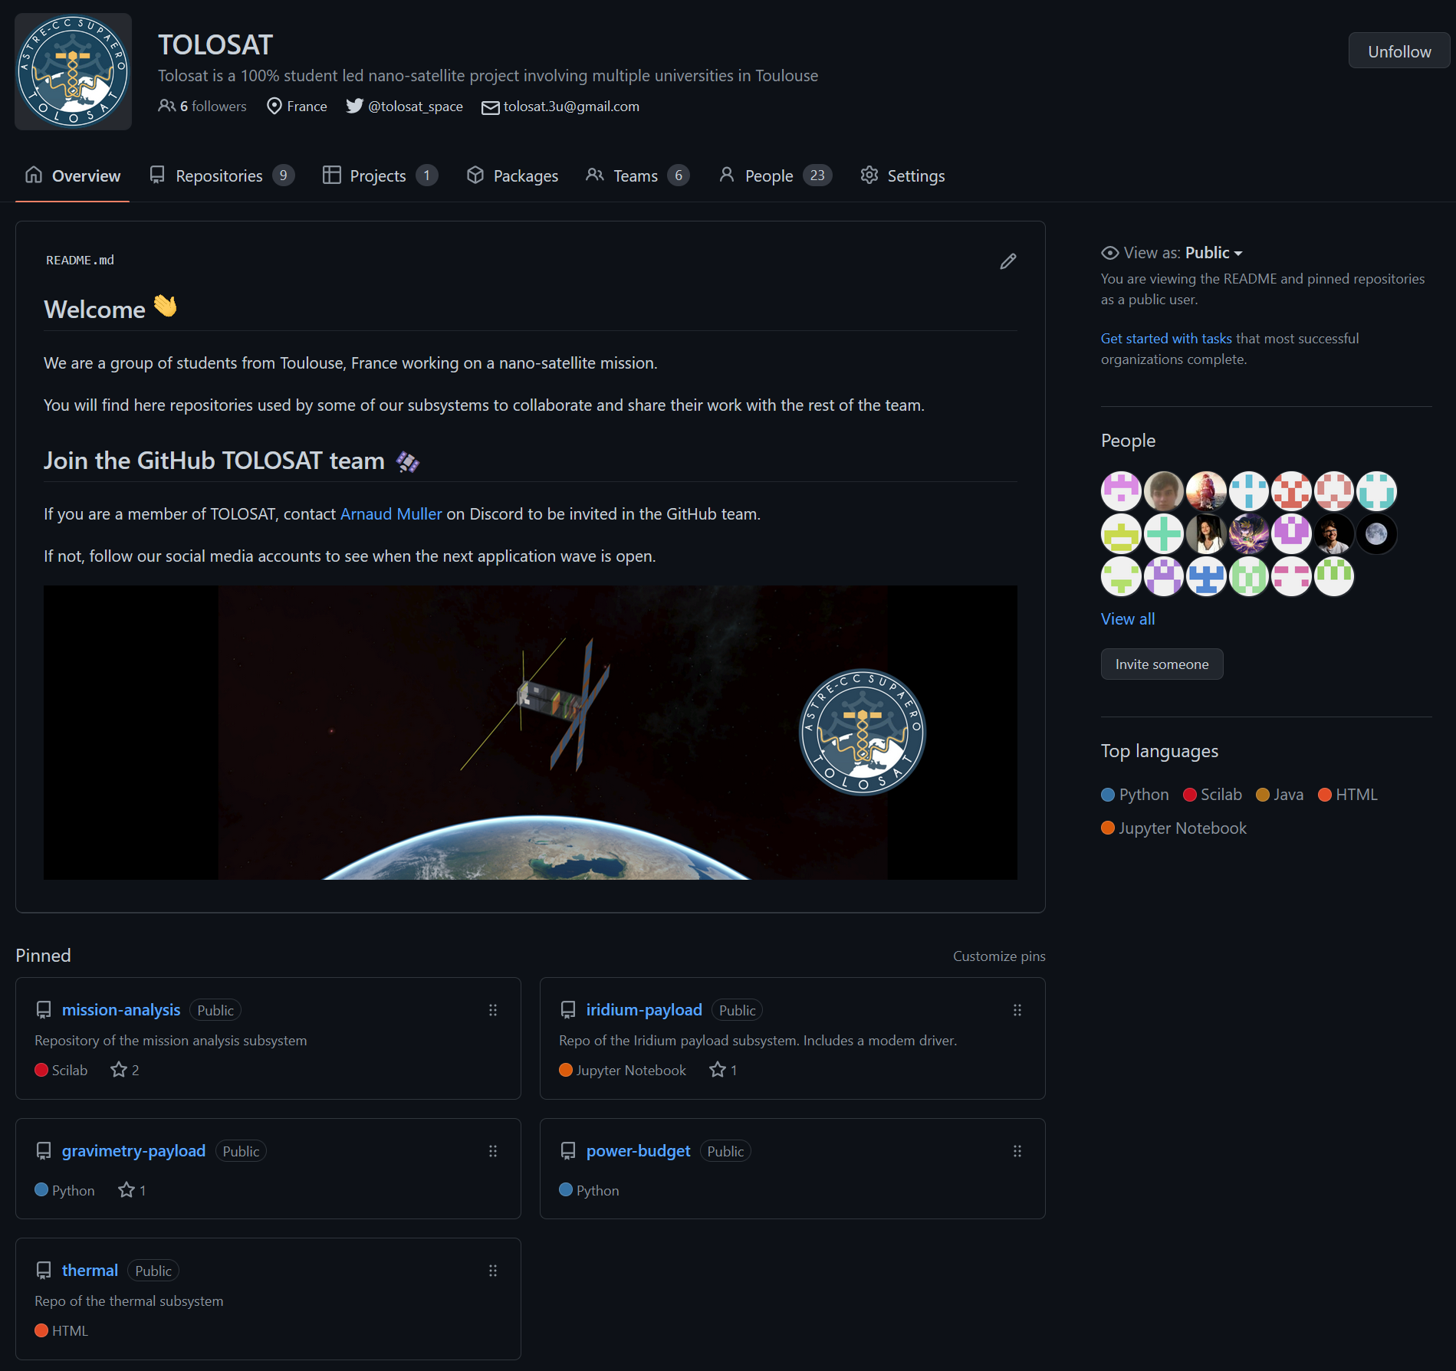
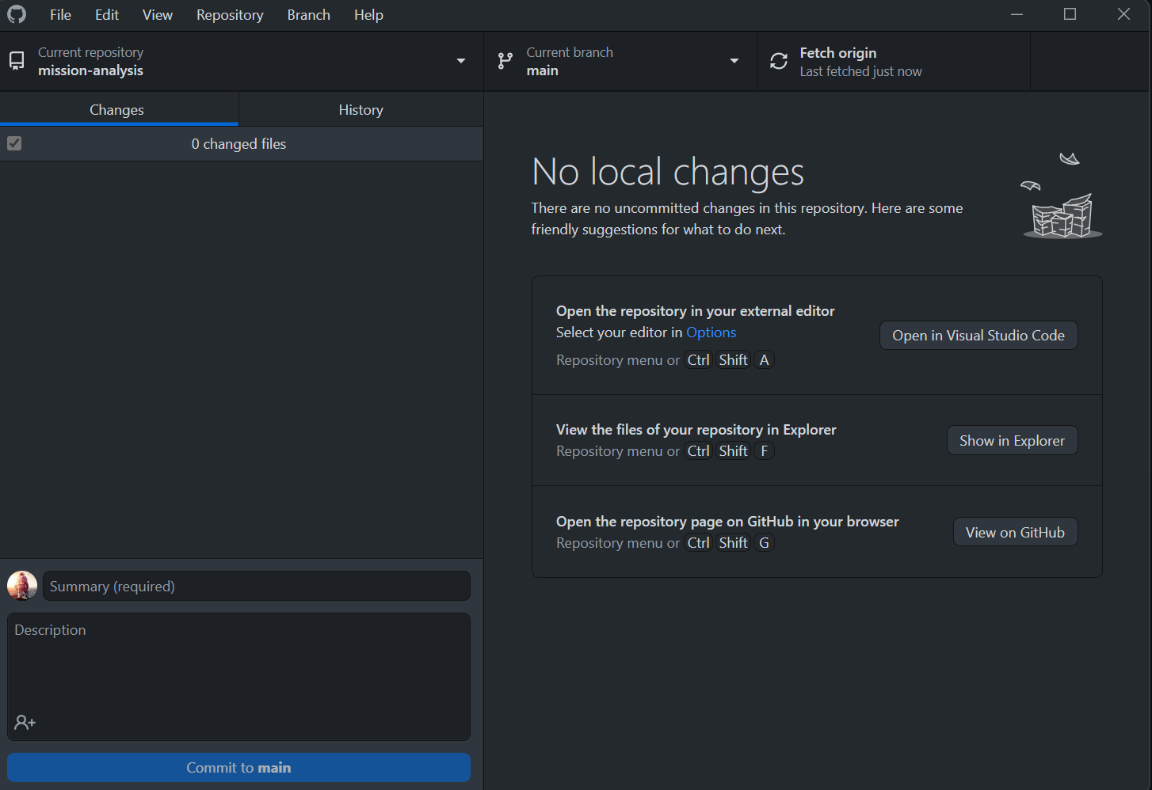
Collaborative Coding
To join the TOLOSAT GitHub organization → give your username/email to the person linked on the page
TOLOSAT
05/2021
Mission Analysis in Python
10

Slide 11
Useful Links
TOLOSAT
TOLOSAT GitHub : https://github.com/TOLOSAT
Mission Analysis Repository : https://github.com/TOLOSAT/mission-analysis
Detailed setup guide (with more links) : https://github.com/TOLOSAT/mission-analysis/blob/main/python/setup_guide/README.md
GitHub Desktop : https://desktop.github.com/
ANACONDA : https://www.anaconda.com/
Miniforge : https://github.com/conda-forge/miniforge
PyCharm : https://www.jetbrains.com/pycharm/
PyCharm license for students : https://www.jetbrains.com/shop/eform/students
GitHub Global Campus for students : https://education.github.com/globalcampus/student
Tudat documentation : https://docs.tudat.space/en/stable/
Tudatpy API Reference : https://py.api.tudat.space/en/latest/
Mission Analysis in Python
11

Slide 12
The End
… or the beginning !
04/2023

